Slide 1


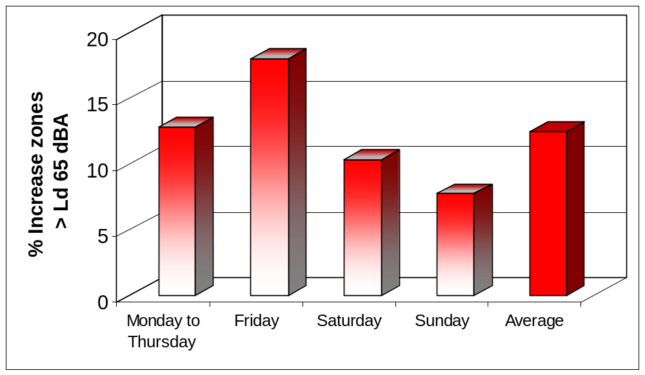
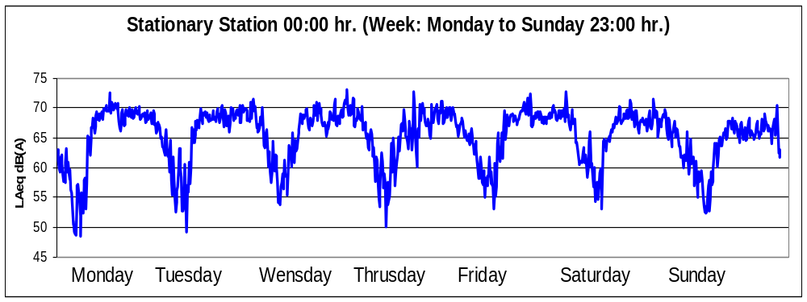
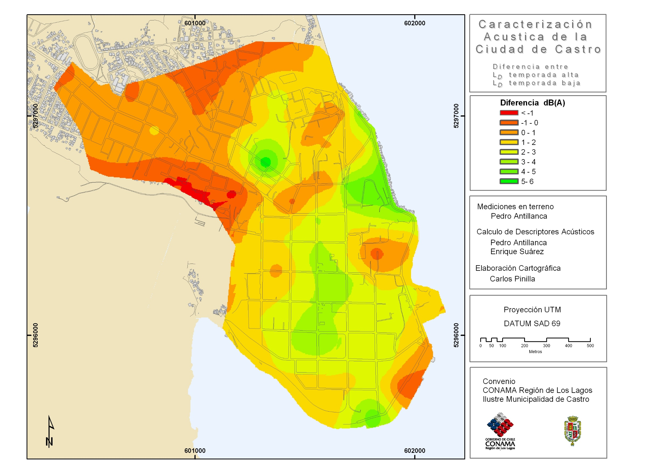
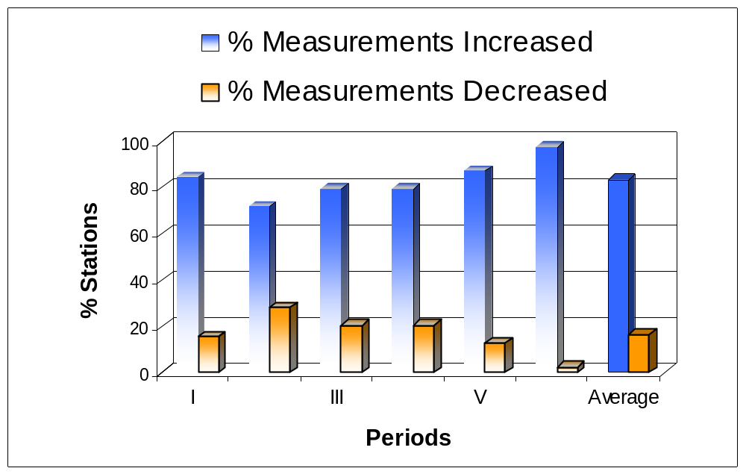
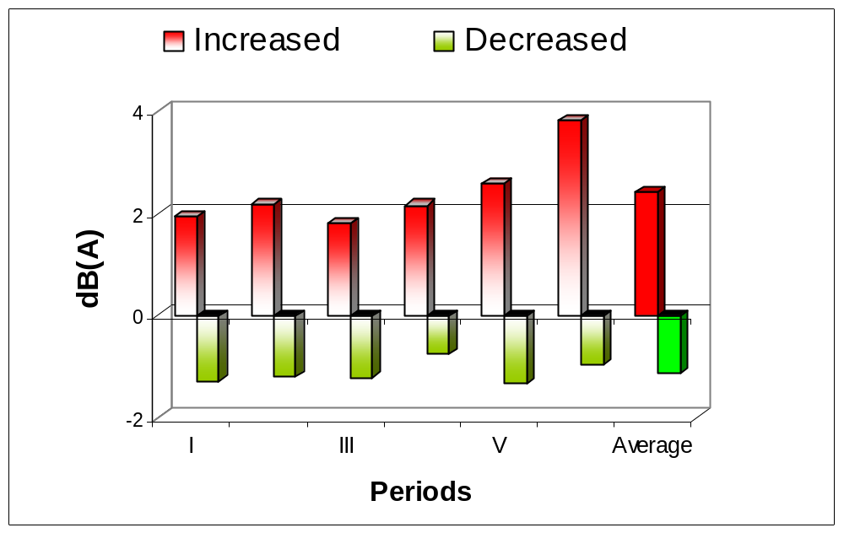
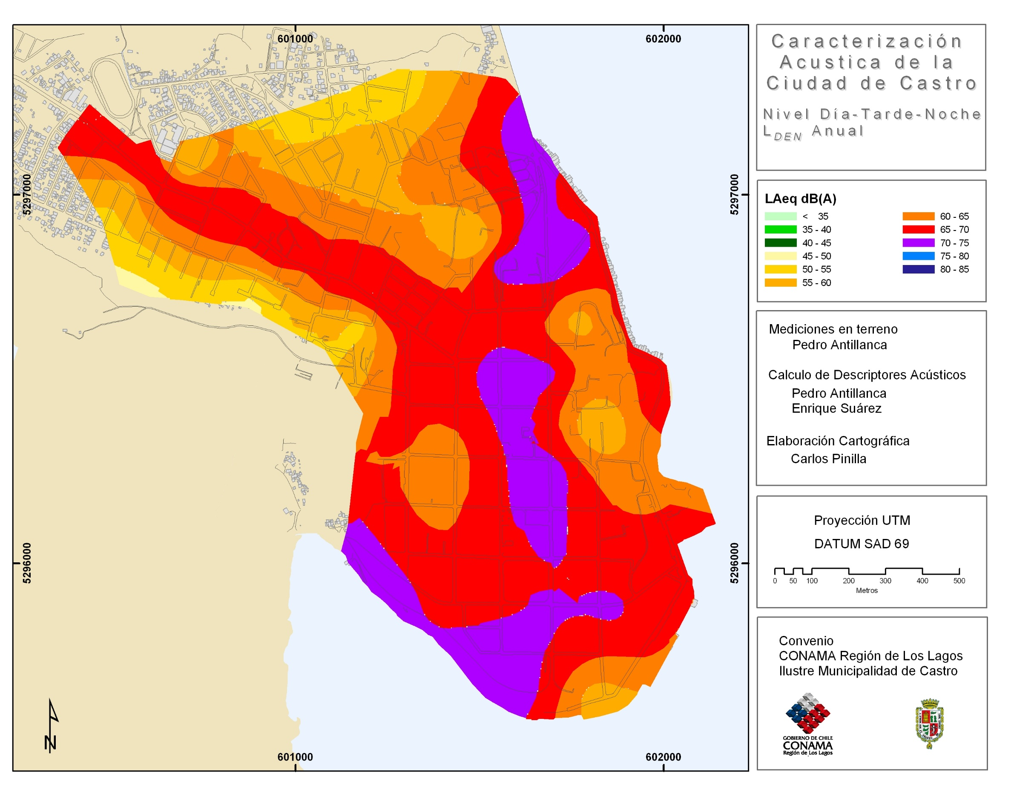
Influence of Tourists on Environmental Noise of a Small City (Castro, Chile)
Suárez Silva, Enrique ^{a,c}; Antillanca Cabezas, Pedro ^{b}
^{a,b} Instituto de Acústica, Universidad Austral de Chile, Valdivia, Chile.
^{c} Comisión Nacional del Medio Ambiente, Región de Los Lagos, Valdivia, Chile.
ª enriquesuarez@uach.cl; ª pedroantillanca@uach.cl; ^{c} esuarez.10@conama.cl
Introduction
Criteria OECD
A comparison according to the criterion of OECD (acceptable limit for existing residential zones Ld < 65 dB (A)), between the two campaigns of measurement of the diurnal periods is presented (Figure 2).
Stationary Station
This work shows an analysis of the acoustic behaviour of a small tourist city of south of Chile (Castro). Castro is Provincial Capital, and has around 30.000 inhabitants. An important characteristic in the urbanization of this city is the freeway through the downtown. The main industrial activity in the city is, fundamentally, in activities related to the industry of the salmon. For the transport of these products it is necessary trucks of great size. The measurements of levels of sonorous pressure were made in low tourist season (winter) and high tourist season, and study of the their difference.
The study of the variation of the sonorous levels in a certain location during the 24 hours of the day supposes knowledge of the temporary variation of these levels. In Figure 4 it shows as they vary the noise levels each one-hour during one week.
Objective
a) To analyse the difference of environmental noise in a small city in two seasons: tourist not season and high tourist season.
b) To characterize environmental acoustic of city, and obtain maps of annual noise average.
Figure 4: Noise Levels in Stationary Station.
Methods
Figure 2: Variations Acceptable limit residential zones criteria.
Mapping noise (seasons difference)
A mixed methodology was used. This method is based on the use of the method of the grid, and soon on the priority of points according to the method of the avenue. A grid of 200x200 m was superposed to the plane of city. The total of measurement stations was 39 distributed around the city. Equivalent Continuous Level was evaluated (Leq dB(A)) during 10 minutes for diurnal measurements, and 20 minutes for nocturnal measurements. The day was divided in six periods, 4 diurnal and 2 nocturnal ones: 07 to 11 hrs., 11 to 15 hrs., 15 to 19 hrs., 19 to 23 hrs., 23 to 03 hrs., and 03 to 07 hrs. (436 samples and 166 hours of measurement). The sonorous level was studied in continuous form during the 24 hours. For these effects, a stationary station of continuous measurement was implemented during one week.
The methodology establishes that there are similar days of Monday to Thursday (workable days), and Friday, Saturday and Sunday are different days. Thus, for every week measurement four days different studied. Two periods of measurements were made: high tourist period and low tourist period. The measurements were made during 2004 and 2005.
The noise increases in high tourist period. Number of zones of the city decreases that satisfy criterion the OECD (65 dBA <Ld). The increase average of zones of the city that exceed Ld 65 dBA is 12,5%.
Figure 5 shows the acoustic difference between the seasons tourist high (noisier) and the loss (less noisy). The difference is obtained from the diurnal measurements (Ld).
Differences between the two seasons
Figure 3 shows 83.3% (average) of the measurements increased. The increase average is 2.4 dBA. For both cases the detail per periods of measurement is shown.
Results
Figure 3. Variations of Measurement
Mapping Noise
Prediction of Traffic Noise
Figure 5. Noise Difference Map
One of the main problems of environmental noise is produced by the rolled traffic. The factors that influence in the traffic noise are mainly the number of vehicles, composition of the traffic, situation of the measurement point and the speed.
Conclusions
It exists differences between the levels of measured noise the two seasons (low and high tourist period).
In Castro city, according to in criterion of the OECD, high tourist period increases between 7.7 to 18 % of zones of the city (> 65 dB(A)).
Points are identified that present a level over 65 dB(A) are repeated in the two seasons (high and low tourist). These points are over of this limit in all the diurnal periods.
The main sources of noise are trucks, some constructions, and irresponsibility of drivers (high speed of trucks and vehicles in general).
The highway that crosses the city is where a level of high noise appears.
The season of the year and the activities of the city (tourism) influence in a noise map. A noise map that represents an annual average must analyze this situation (Example: this work)
Period | Equation | Correlation coefficient R | Average Error Abs dB(A) | D. standar Error Abs. dB(A)
Day Short Equation | LAeq=9,79*Loq(Q)+49,52 | 0,72 | 2,48 | 1,68
Day 2 Long Equation | LAeq=56,11+6,83*Log(Q)+ 1,23*Log(Qm)+ 4,49*Log(Qp)-0,7*d | 0,84 | 2,04 | 1,48
Night 1 Short Equation | LAeq=9,39*Loq(Q)+48,13 | 0,74 | 2,8 | 1,85
Night 2 Long Equation | LAeq=51,34+9,22*Log(Q)+ 3,65*Log(Qp)-0,52*d | 0,82 | 2,34 | 1,59
Figure 1: Noise Map Lden Annual
Table 1. Equations of prediction of traffic noise.
Map of noise of the city was developed. Figure 1 shows to Lden map annual average (weekly and annual average).
Simple equations were calculated (simple regression). The equations show the influence of the heavy traffic (trucks) in the noise emission (Table 1).

